Slide 1

Translational Pathology Pathology and Laboratory Medicine UT MD Anderson Cancer Center
Kasthuri Kannan, PhD
Associate Professor
Translational Molecular Pathology
UT MD Anderson Cancer Center

Slide 2
Contents
Objective
Background
Bird’s eye view of spatial statistics
Implementation (proof of principle)
A peek into translational pathology
Execution

Slide 3
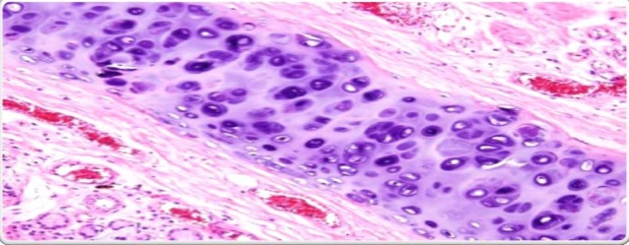

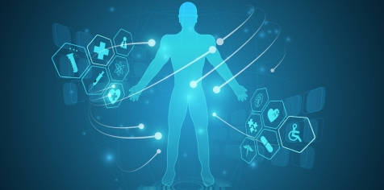
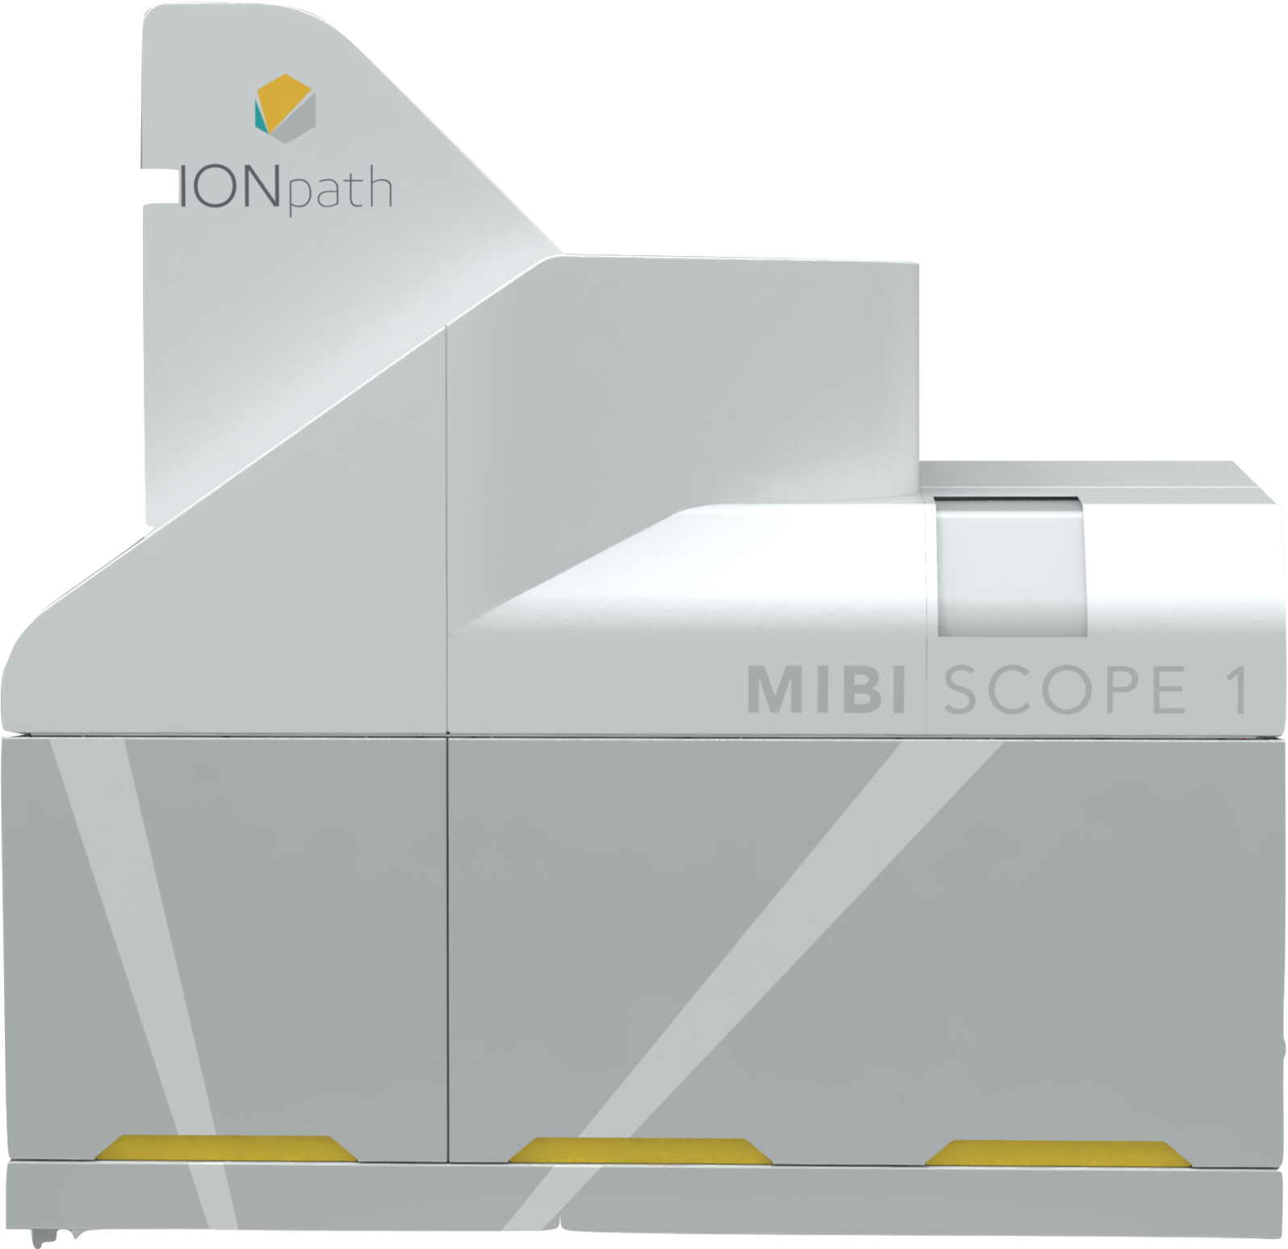
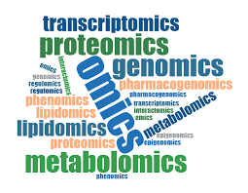
Objective
Array of technologies and data
Low-plex
Clinical data
Hi-plex
Translational Pathology Solution
low-plex
(standard package)
basic spatial statistics, risk estimation, custom low-plex analysis, clinical data integration
hi-plex
(standard package)
spatial statistics (all phenotypes),
phenotype specific statistics,
dependency, interaction, risk estimation analyses, clinical data integration
consulting/education
based approach
custom
(advanced package)
omics integration, custom hi-plex analysis, research consulting, innovation/publication specific analysis

Slide 4

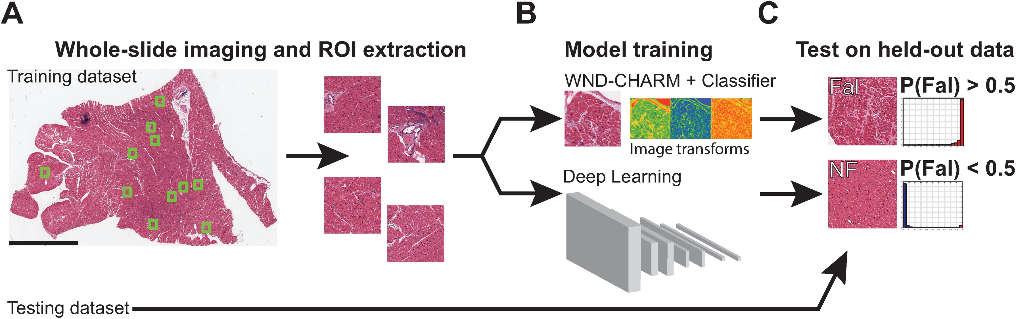
Background
Data integration
H&E
IHC
Should be inclusive of all platforms
Digital pathology through machine learning models?
Not inclusive enough!
Depends more on imaging features than on cells and biology
CODEX
ISH
DSP
mIF
MIBI
IMC
Deep learning models depend on imaging features but not the cells themselves
Spatial statistics + Machine learning = Translational pathology
What we need is translational pathology and not digital pathology!

Slide 5
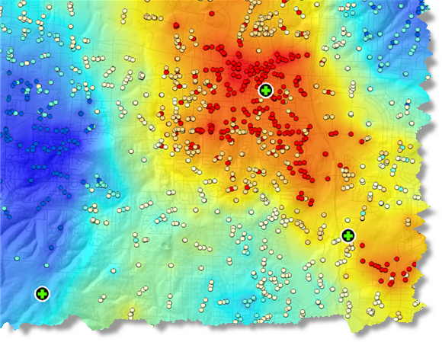
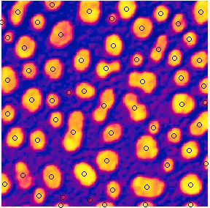
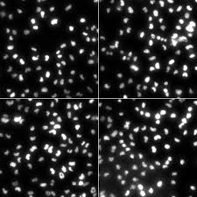
Spatial Statistics
What is spatial statistics?
How a bunch of points are organized in space?
Geographical information systems
A collection of cells
Several configurations belong to the same underlying process, also known as the random process
Tossing a coin, or rolling a die
How the cells move/proliferate in the first place?
Traditional image analysis models using machine learning don’t capture this info

Slide 6
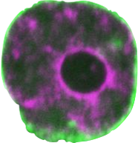
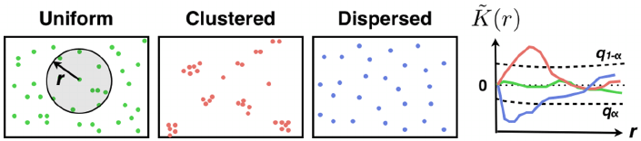
Example
Expected number of cells around a cell
R4
R3
15
R2
13
R1
8
1
R1
R2
R3
R4
Increases with R, so divide by the density
Total randomness means uniform increase

Slide 7
Spatial Measures
Other cell based measures
Clustering, dispersion or uniformly random of all cells in the chosen region.
Specific mark based measures. Are CD3+ cells clustering?
How much one mark is associated with other mark? Or with the population?
Nearest neighbor based (dependency analysis) or all neighbor based (interaction analysis).
1
2
9
3
c
CD68+ cells | Nearest Neighbor (CD3+) | Distance
a | 7 | 2.9
b | 8 | 3.5
c | 10 | 5.3
4
a
b
10
5
7
8
6
CD68+ cells
CD3+ cells

Slide 8
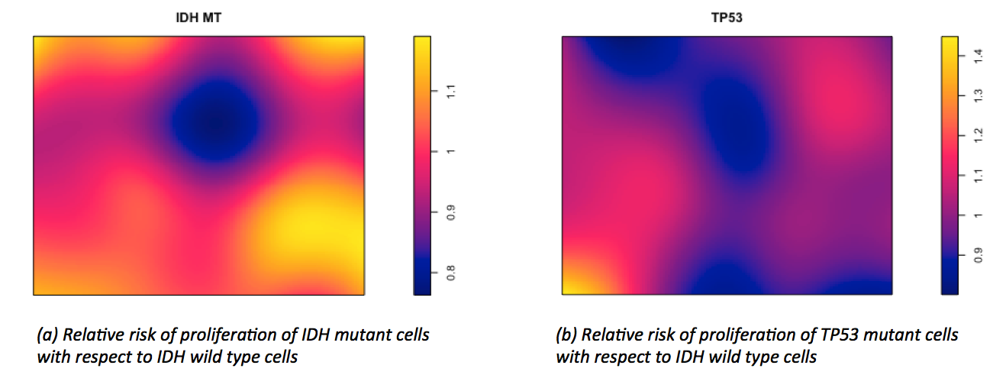
Proliferation
Relative risk estimation
Do cells of a particular mark proliferate faster than any mark?
Do CD3+ cells proliferate faster than CD68+ cells?
Relative measure of proliferation is given by the ratio of local relative density of different phenotypes/marks.

Slide 9
Implementation
Power of spatial statistics
Spatial statistical analysis is a very powerful analysis tool, especially when integrated with clinical and omics data.
Facilitates translational research with ease.
Very relevant from clinical and biological standpoint.
Applicable to all technologies, including H&E with single staining!
Several examples can be seen at the newly established website:
https://kannan-kasthuri.github.io/PLDIV01/Tpath.html

Slide 10


Execution
Translational pathology initiative at the Division of Pathology, MDACC
Consulting and education based initiative
low-plex
(standard package)
Translational Pathology
Form
hi-plex
(standard package)
custom
(advanced package)
Investigator/Clinician/Pathologist/Alliances
Education
Advise on the best possible imaging and analysis option for their research

Slide 11
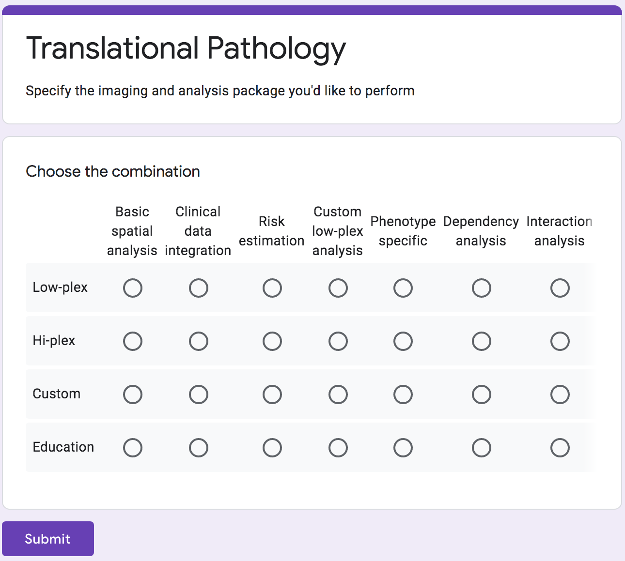
A Basic Form
Imaging + Analysis package

Slide 12
Summary
Translational Pathology
Translational Pathology
Education
Advise on the best possible imaging and analysis option for their research
Investigator/Clinician/Pathologist/Alliances
low-plex
(standard package)
basic spatial statistics, risk estimation, custom low-plex analysis, clinical data integration
hi-plex
(standard package)
spatial statistics (all phenotypes),
phenotype specific statistics,
dependency, interaction, risk estimation analyses, clinical data integration
custom
(advanced package)
omics integration, custom hi-plex analysis, research consulting, innovation/publication specific analysis

Slide 13
Support
Acknowledgements
Dr. Solis Soto, Luisa Maren, for providing the H&E single & dual staining, IHC Tumor, IHC Tumor & Stroma and ISH RNAscope images and the processed data.
Dr. Yang, Fei for providing mIF triple negative breast cancer images and data.
Dr. Francisco Cruz, Alejandro for providing mIF, IMC images and data.
Dr. Sanchez Espiridion, Beatriz, for helping with logistics
Dr. Parra Cuentas, Edwin Roger
Dr. Wistuba, Ignacio, for initiating this project.
TMP-IL team and TMP for their support.

